Slide 1
Depth-First Search
Oradea
In fringe (stack)
71
Neamt
Visited city
Zerind
151
87
75
Iasi
Arad
140
99
Fagaras
92
Sibiu
Vaslui
118
80
Rimnicu Vilcea
211
142
Timisoara
97
Urziceni
98
Hirsova
111
85
Lugoj
Pitesti
101
86
146
Bucharest
70
Eforie
Mehadia
138
90
75
Dobreta
120
Giurgiu
Craiova

Slide 2
Breadth-First Search
Oradea
In fringe (queue)
71
Neamt
Visited city
Zerind
151
87
75
Iasi
Arad
140
99
Fagaras
92
Sibiu
Vaslui
118
80
Rimnicu Vilcea
211
142
Timisoara
97
Urziceni
98
Hirsova
111
85
Lugoj
Pitesti
101
86
146
Bucharest
70
Eforie
Mehadia
138
90
75
Dobreta
120
Giurgiu
Craiova

Slide 3
Depth-Limited Search
In fringe (stack)
Oradea
71
Neamt
Visited city
Zerind
151
87
Depth=3 but not the goal
75
Iasi
Arad
140
99
Fagaras
92
Sibiu
Vaslui
118
80
Rimnicu Vilcea
211
142
Timisoara
97
Urziceni
98
Hirsova
111
85
Lugoj
Pitesti
101
86
146
Bucharest
70
Eforie
Mehadia
138
90
75
Dobreta
120
Giurgiu
Craiova

Slide 4
Uniform-Cost Search
146
In fringe (priority queue)
Oradea
75
71
Neamt
Visited city
Zerind
151
87
75
Iasi
Arad
140
239
0
99
Fagaras
92
Sibiu
140
80
Vaslui
118
Rimnicu Vilcea
211
142
Timisoara
220
97
Urziceni
118
98
Hirsova
111
85
Lugoj
Pitesti
450
317
101
86
229
146
Bucharest
70
418
Via Pitesti
Eforie
Mehadia
138
299
90
75
Dobreta
120
Giurgiu
366
374
Craiova

Slide 5
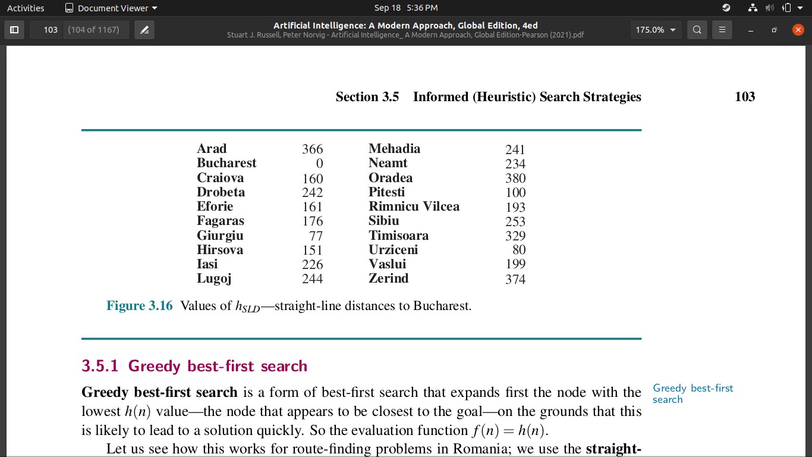
Greedy Best-First Search
380
Oradea
71
Neamt
374
Zerind
151
87
75
Iasi
Arad
140
176
366
99
Fagaras
92
Sibiu
253
80
Vaslui
118
Rimnicu Vilcea
211
142
193
97
Urziceni
98
Hirsova
Timisoara
111
329
85
Straight-line distances to Bucharest
Lugoj
Pitesti
101
86
70
146
Bucharest
0
Eforie
Mehadia
138
90
75
Giurgiu
In fringe (priority queue)
Dobreta
120
Craiova
Visited city

Slide 6
A* Search
380 + 291
Oradea
374 + 75
71
Neamt
Zerind
151
87
75
Iasi
Arad
140
176 + 239
366 + 0
99
Fagaras
92
Sibiu
253 + 140
80
Vaslui
118
Rimnicu Vilcea
211
142
193 + 220
97
Urziceni
98
Hirsova
Timisoara
111
100 + 317
447 + 118
85
Straight-line distances to Bucharest
Lugoj
Pitesti
101
0 + 450
86
70
146
Bucharest
0 + 418
Via Pitesti
Eforie
Mehadia
138
90
75
Giurgiu
In fringe (priority queue)
Dobreta
120
160 + 366
Craiova
Visited city

